Slide 1


Business
Presentation
Innovate. Connect. Grow.
Empowering businesses to achieve
sustainable growth through innovation
and strategic solutions.

Slide 2
Agenda
01
02
03
04
05
Introduction
Our Strategy
Solutions
Market Insights
Next Steps
Who we are
Our approach
What we offer
Industry overview
Let's achieve more

Slide 3

About Us
We are a team of passionate
professionals dedicated to delivering
innovative solutions that drive growth
and create lasting impact.
Our Mission
To empower businesses with
data-driven strategies.
Our Vision
To be a global leader in innovative
business solutions.
Our Values
Integrity, Innovation, Collaboration,
and Excellence.

Slide 4
Our Strategy
Understand
We analyze your business and market landscape.
Plan
We craft data-driven strategies tailored to your goals.
Execute
We implement with precision and agility lorum ipsum.
Strategic thinking.
Measurable results.
Optimize
We measure, learn, and continuously improve.

Slide 5
Solutions
Comprehensive solutions to accelerate your business growth.
Business Consulting
Digital Transformation
Marketing Solutions
Strategic guidance to
improve performance and
achieve your goals.
Leverage technology to
streamime operations and
deliver value.
Data-driven marketing
strategies that build brand
and drive growth.

Slide 6
Market Insights
Key industry trends
shaping the future
The market is evolving rapidly. Stay ahead with insights that matter.
Market Growth
Digital Adoption
Customer Demand

Slide 7
Key Metrics
Performance highlights
from our impact
250+
98%
45%
10+
Clients Served
Client Satisfaction
Average Growth
Years of Experience
Across diverse
industries
Built on trust and
results
Achieved by our
clients
Delivering impactful
solutions

Slide 8
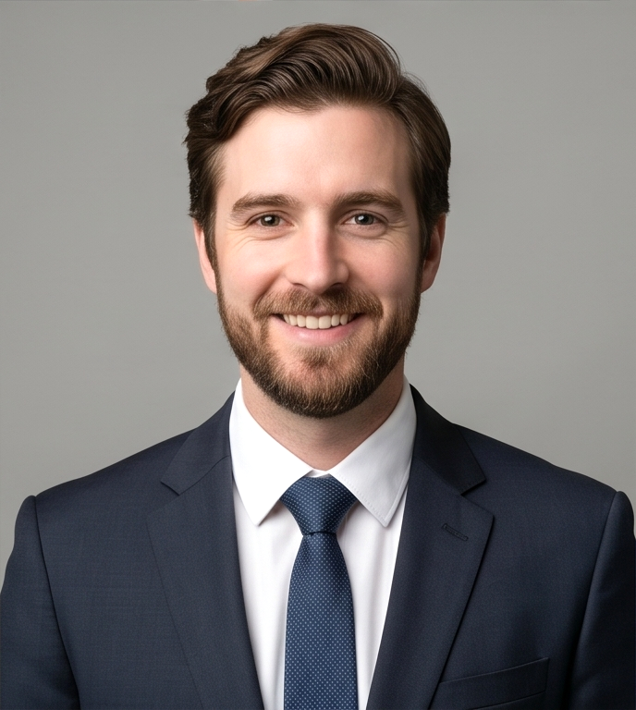
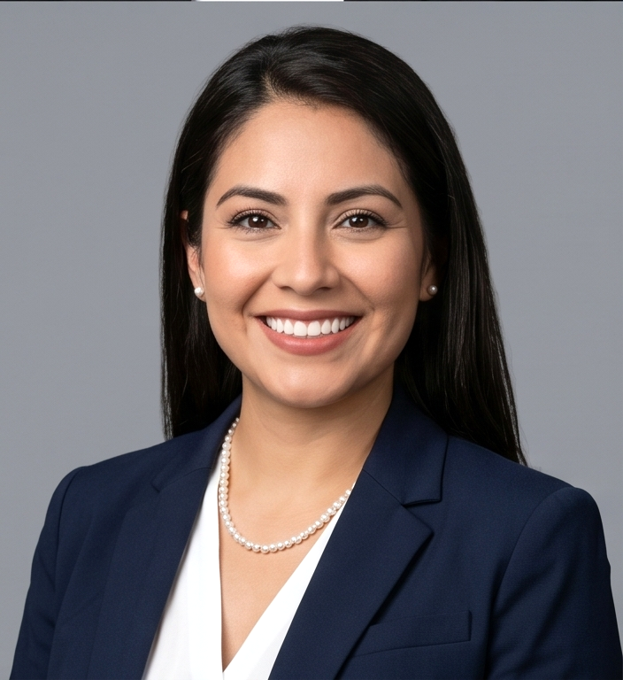

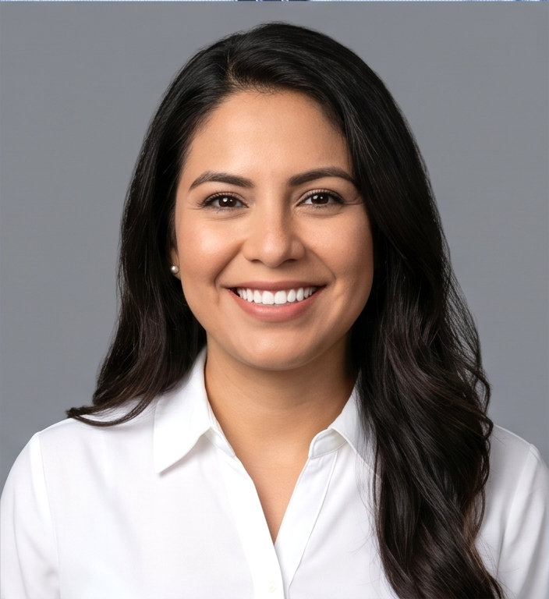
Our Team
Experts dedicated to your success
James Carter
Sophia Lee
Daniel Miller
Olivia Brown
CEO & Founder
Head of Strategy
Head of Operations
Head of Marketing
Strategic Vision
& Leadership
Business Strategy
& Planning
Operations & Process
Excellence
Brand Strategy &
Growth Marketing

Slide 9

Next Steps
Let's build a successful
future together.
Schedule a Consultation
Let's discuss your goals and
Objectives.
Create a Plan
We'll design a strategy
just for you.
Achieve Results
Together, we grow.
Thank You!

